Slide 1









Homework - HTML & CSS Framework
Chasetyo Ivan Yusaga

Slide 2



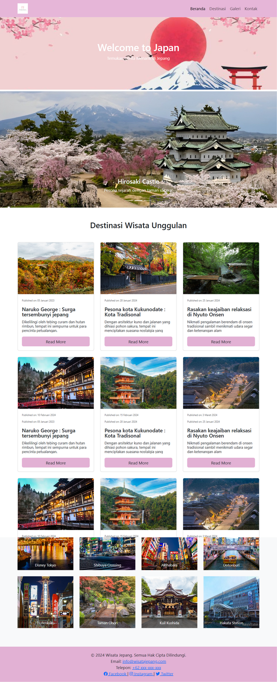
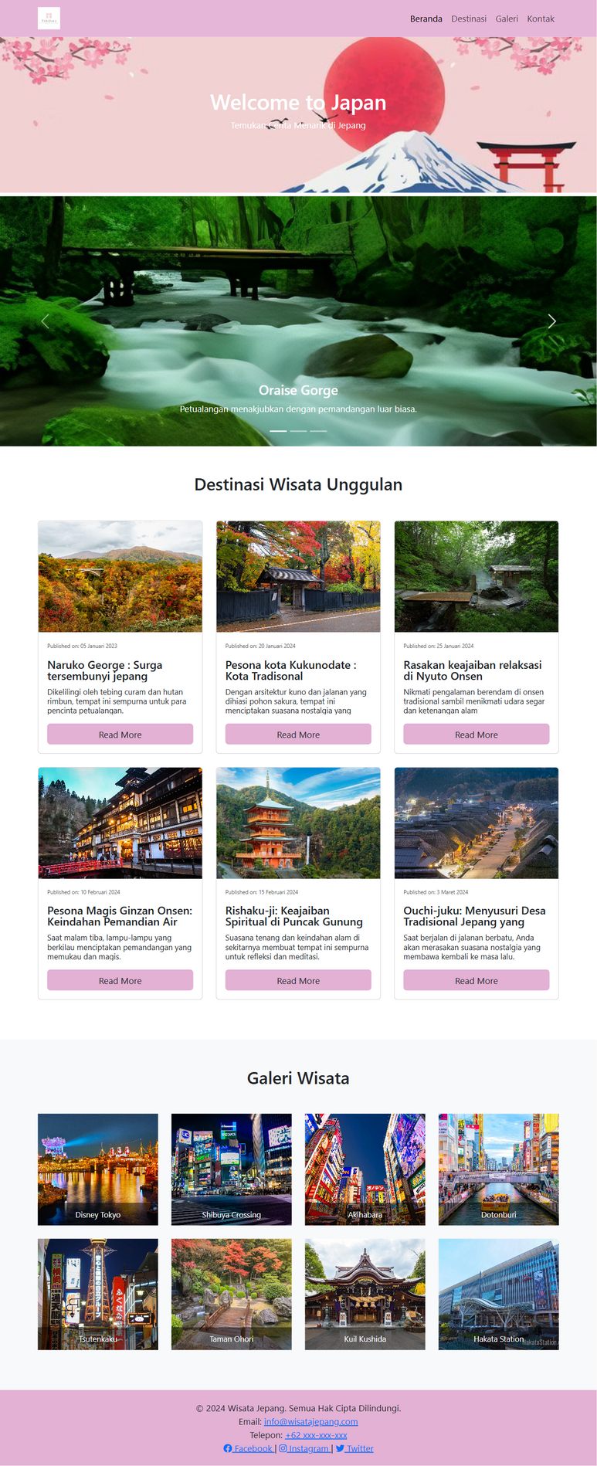
Tampilan Website

Slide 3
Tampilan Mobile

Slide 4


Link
Link Youtube Demonstrasi
1
https://youtu.be/Mp9WK30YH6g?si=JufB9GHY9qsxhjk9
Link Code Github
2
https://github.com/IvanYusaga/WebsiteWisataJepang

Slide 5



Terima Kasih

